Slide 1
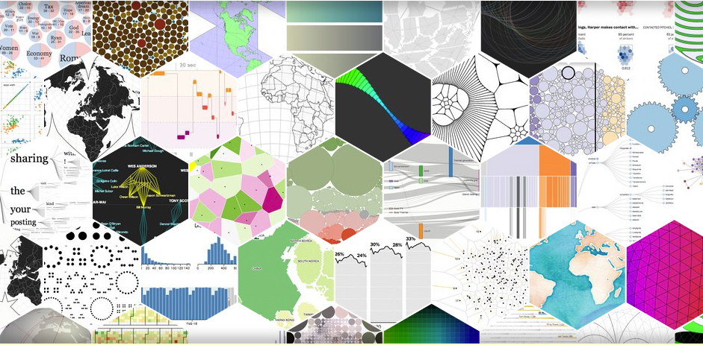

Visualisasi Data dan Informasi - Farid Ridho
Creating Visual Representations

Slide 2
Outline
A Reference ModeL
Designing a Visual App
Visual Representation of Linear Data
2D vs. 3D
Conclusion

Slide 3
Introduction
In this chapter, we’ll take a closer look at the process of generating an artifact of visual representation, or rather the mechanism that creates a visual representation from a certain number of data, using specific computer processes.
We will discuss some common techniques for visualizing linear data structures.

Slide 4
A Reference Model
Let’s imagine that we have at our disposal a collection of data on which we’d like to carry out explorative analysis to identify any possible unknown tendencies or relationships

Slide 5
Apache Log Data
10.185.248.71 - - [09/Jan/2015:19:12:06 +0000] 808840 "GET /inventoryService/inventory/purchaseItem?userId=20253471&itemId=23434300 HTTP/1.1" 500 17 "-" "Apache-HttpClient/4.2.6 (java 1.5)"

Slide 6
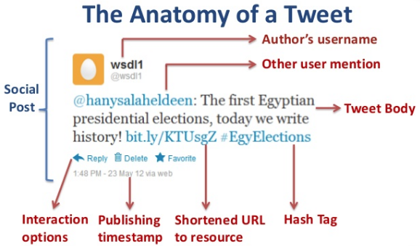
Twitter Data

Slide 7
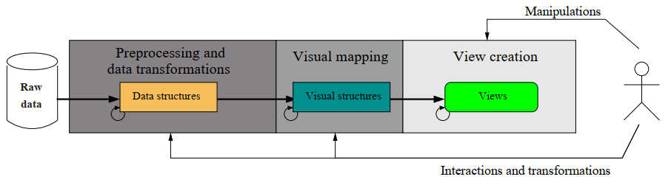
A Reference Model

Slide 8
Preprocessing and Data Transformations
We use the term “raw” to describe data supplied by the world around us.
We use the term “raw” to describe data supplied by the world around us.
The structure usually used for this type of data is tabular—the arranging of data in a table—in a format appropriate for the software that must receive and process them.

Slide 9
Preprocessing and Data Transformations
Log File
[Tue 1 March 2005, 10:22 AM] Luigi "add post" [Tue 1 March 2005, 10:26 AM] Orazio "view discussion" [Tue 1 March 2005, 11:02 AM] Luigi "add post" [Tue 1 March 2005, 02:02 PM] Enzo "view discussion" [Tue 1 March 2005, 02:04 PM] Enzo "view discussion

Slide 10
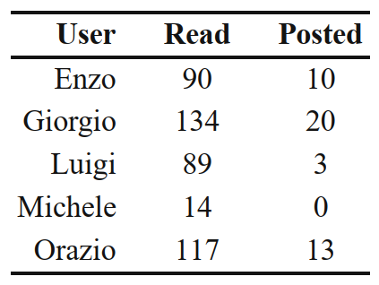
Preprocessing and Data Transformations

Slide 11
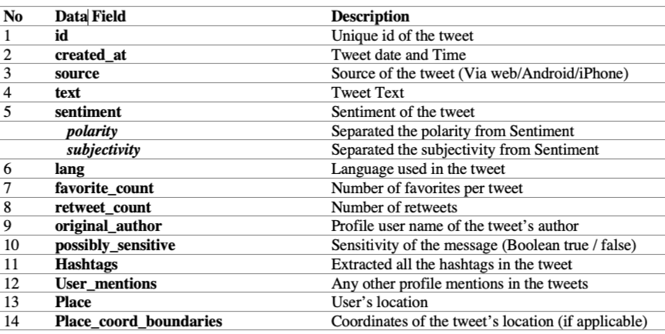
Twitter data Preprocessing

Slide 12
Twitter data Preprocessing
Removing symbols, numbers, ASCII strings, and punctuations.
Tokenization
Case folding
Stemming
Stopword removal
Special Symbols on Twitter (#, @, RT)
Handle Emoticons and Emojis

Slide 13
Visual mapping
The key problems of this process lie in defining which visual structures to use to map the data and their location in the display area.
Spatial substrate
Graphical elements
Graphical properties

Slide 14
Spatial substrate
defines the dimensions in physical space where the visual representation is created.
The spatial substrate can be defined in terms of axis
In Cartesian space, the spatial substrate corresponds to x- and y-axis
Each axis can be of different types, depending on the type of data that we want to map on it

Slide 15
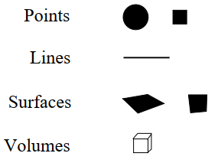
Graphical element
Everything visible that appears in the space.

Slide 16
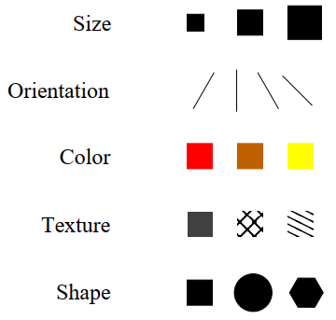
Graphical properties
Properties of the graphical elements to which the retina of the human eye is very sensitive (for this reason, they are also called retinal variables).

Slide 17
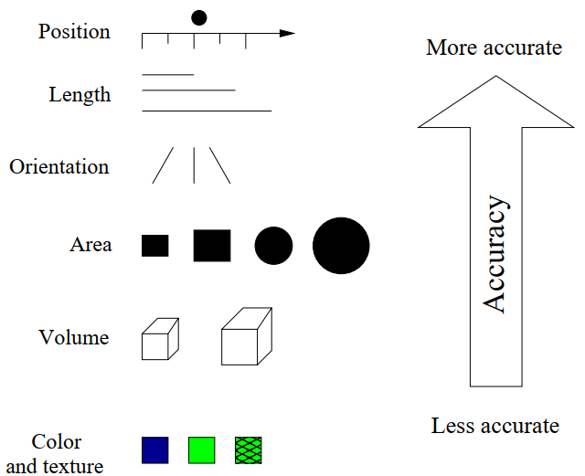
Accuracy in the perception

Slide 18
View creation
The views are the final result of the generation process.
They are the result of the mapping of data structures to the visual structures, generating a visual representation in the physical space represented by the computer.
They are what we see displayed on the computer screen.

Slide 19
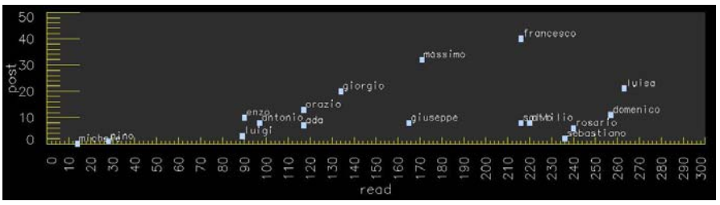
View creation
A possible visual representation of the data collected from a discussion forum

Slide 20
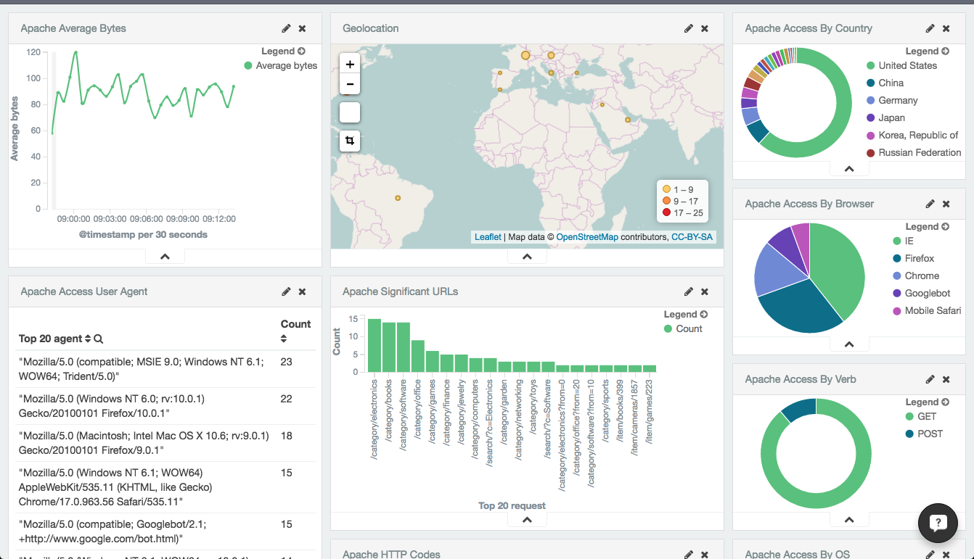
View Creation

Slide 21
Designing a Visual App
A generation process, such as the one described previously, should be preceded by good design.
Correct design is the key to the success of this type of application.
The main problem in designing a visual representation lies in creating visual mapping that, on the one hand, faithfully reproduces the information codified in the data and, on the other, facilitates the user in the predetermined goal.

Slide 22
Designing a Visual App
Define the problem
Examine the nature of the data to represent
Number of dimensions
Data structures
Type of interaction

Slide 23
Define the problem
by spending a certain amount of time with potential users of the visual representation.
Identify their effective needs and how they work.
This is needed to clearly define what has to be represented.

Slide 24
Examine the nature of the data to represent
The data can be quantitative (e.g., a list of integers or real numbers),
ordinal (data of a non numeric nature, but which have their own intrinsic order, such as the days of the week),
or categorical (data that have no intrinsic order, such as the names of people or cities).
A different mapping may be appropriate, according to the data type.

Slide 25
Number of dimensions
The number of dimensions of the data (also called attributes) that we need to represent very importantly determines the type of representation that we use.
The attributes can be independent or dependent.
The dependent attributes are those that vary and whose behavior we are interested in analyzing with respect to the independent attributes.

Slide 26
Data structures
These can be linear (the data are codified in linear data structures like vectors, tables, collections, etc.),
temporal (data that change in time),
spatial or geographical (data that have a correspondence with something physical, such as a map, floorplan, etc.),
hierarchical (data relative to entities organized on hierarchy, for example, genealogy, flowcharts, files on a disk, etc.),
And network (data that describe relationships between entities).

Slide 27
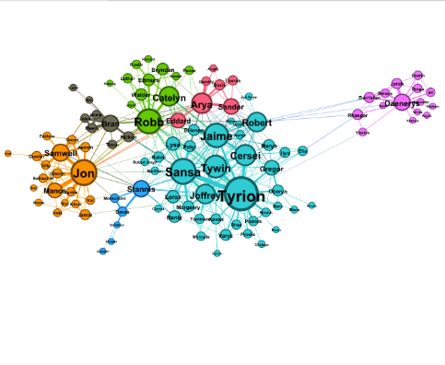
Social Network

Slide 28
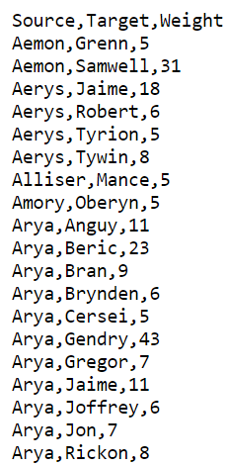
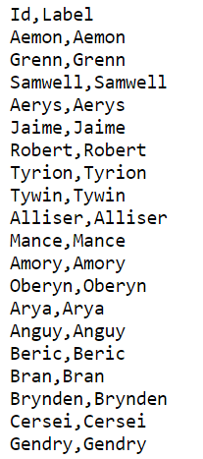
Social Network Dataset
Edge
Node

Slide 29
Type of interaction
This determines if the visual representation is static (e.g., an image printed on paper or an image represented on a computer screen but not modifiable by the user),
transformable (when the user can control the process of modification and transformation of data, such as varying some parameters of data entry, varying the extremes of the values of some attributes, or choosing a different mapping for view creation),
or manipulable (the user can control and modify some parameters that regulate the generation of the views, like zooming on a detail or rotating an image represented in 3D).

Slide 30
Interactive
http://setosa.io/bus/
http://snip.ly/pJsZ#http://www.puffpuffproject.com/languages.html
https://projects.fivethirtyeight.com/complete-history-of-the-nfl/#ari

Slide 31
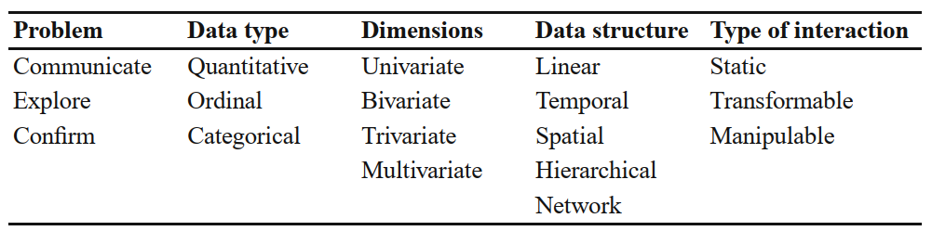
Variables to consider

Slide 32
Visual Representation of Linear Data
A collection of data is defined as univariate when one of its attributes varies with respect to one or more independent attributes.
Let’s suppose that we have to analyze the gross national product (GNP) realized by some nations in 2000.
Another very common form of univariate representation is the bar chart.

Slide 33
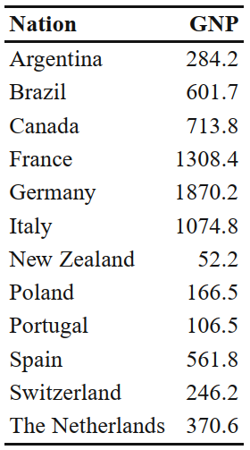
Gross national product (GNP)

Slide 34
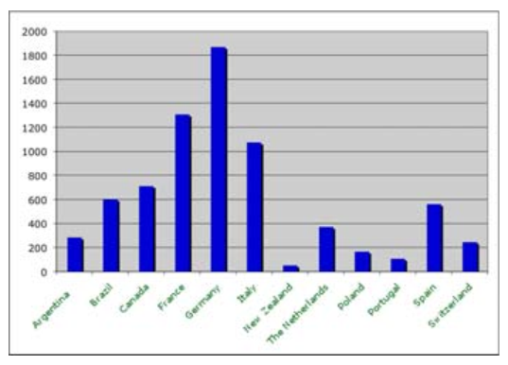
Bar chart

Slide 35
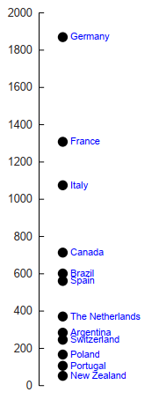
Scatter Plot

Slide 36
Through the scatterplot, we are able to instantly take in the global distribution of GNP all along the values axis,
While the bar chart allows us to make very efficient comparisons between the different nations.

Slide 37
Bivariate
When the number of dependent attributes is two, we speak of bivariate data representation.
owever, to have an effective vision of the import and export distribution of these nations, we can represent these values on a two-axis scatterplot

Slide 38
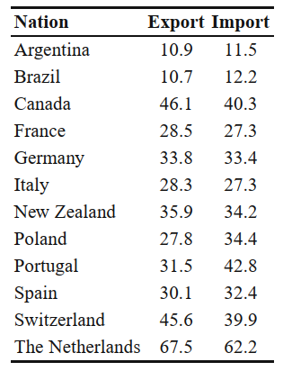
Bivariate

Slide 39
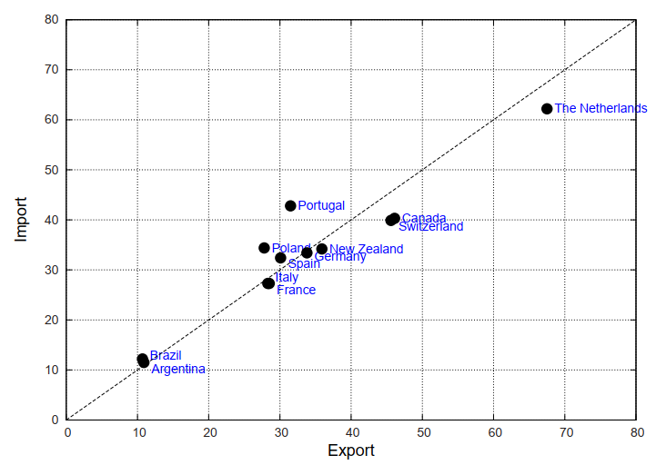
2 Axis Scatter Plot

Slide 40
Trivariate
The term trivariate representation is used when three dependent attributes vary with respect to one or more independent attributes.
This case becomes complicated, since the two spatial dimensions we have used until now to map the dependent attributes are not sufficient.

Slide 41
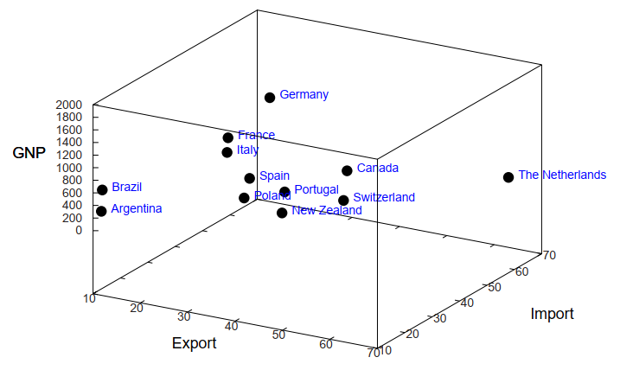
3D Scatter Plot

Slide 42
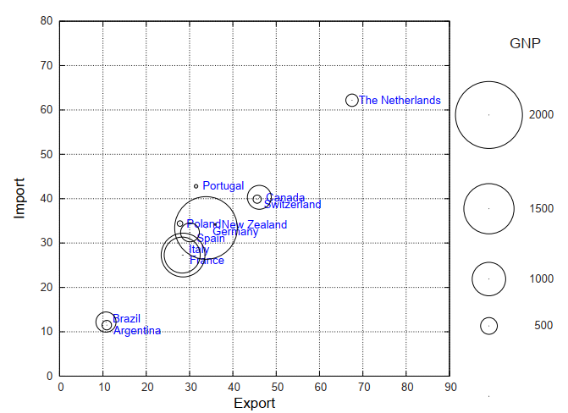
2D Scatter Plot

Slide 43
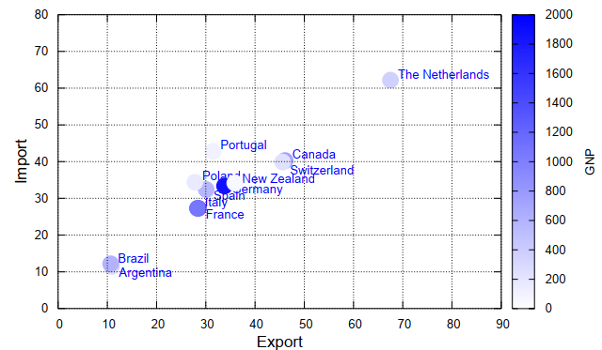
2D Scatter Plot

Slide 44
2D vs. 3D
In the previous section we looked at a situation in which a collection of trivariate data is represented by two-and three-dimensional spatial views.
We have also demonstrated how 2D representations are clearer and more precise than 3D, due to some intrinsic problems that afflict the 3D views.

Slide 45
2D vs. 3D
Furthermore, some empirical studies have shown that 3D representations increase cognitive load, or the user’s mental effort to correctly interpret the data represented
Does this mean that 3D representations are to be avoided in any case? Not always.

Slide 46
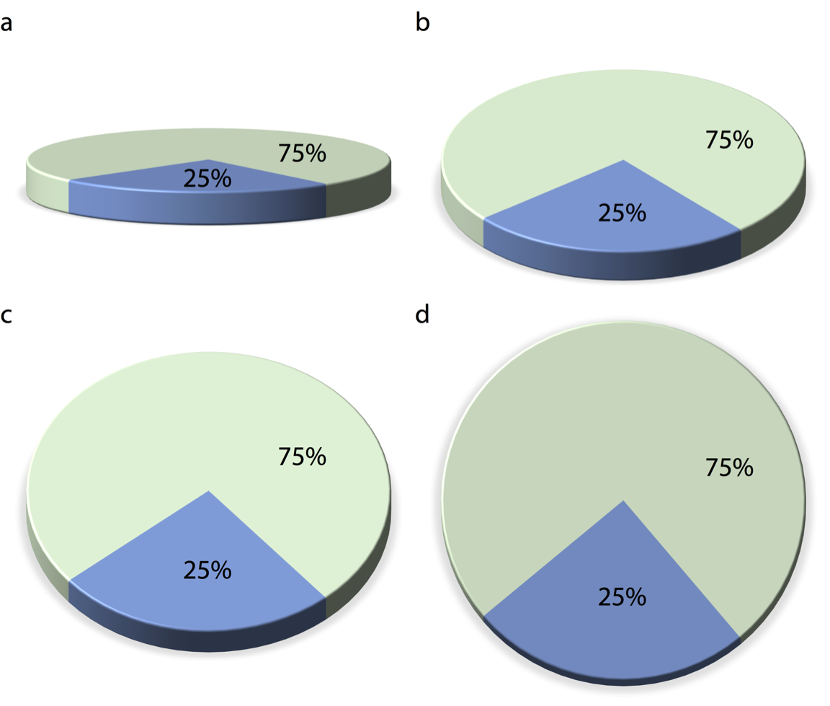
Avoid gratuitous 3D

Slide 47
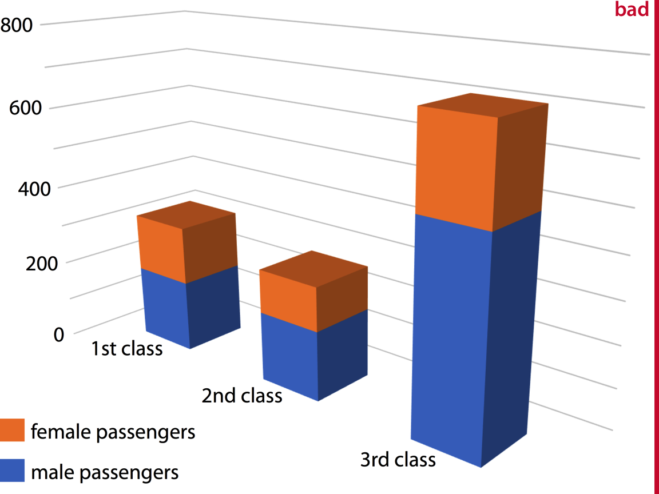
Avoid gratuitous 3D

Slide 48
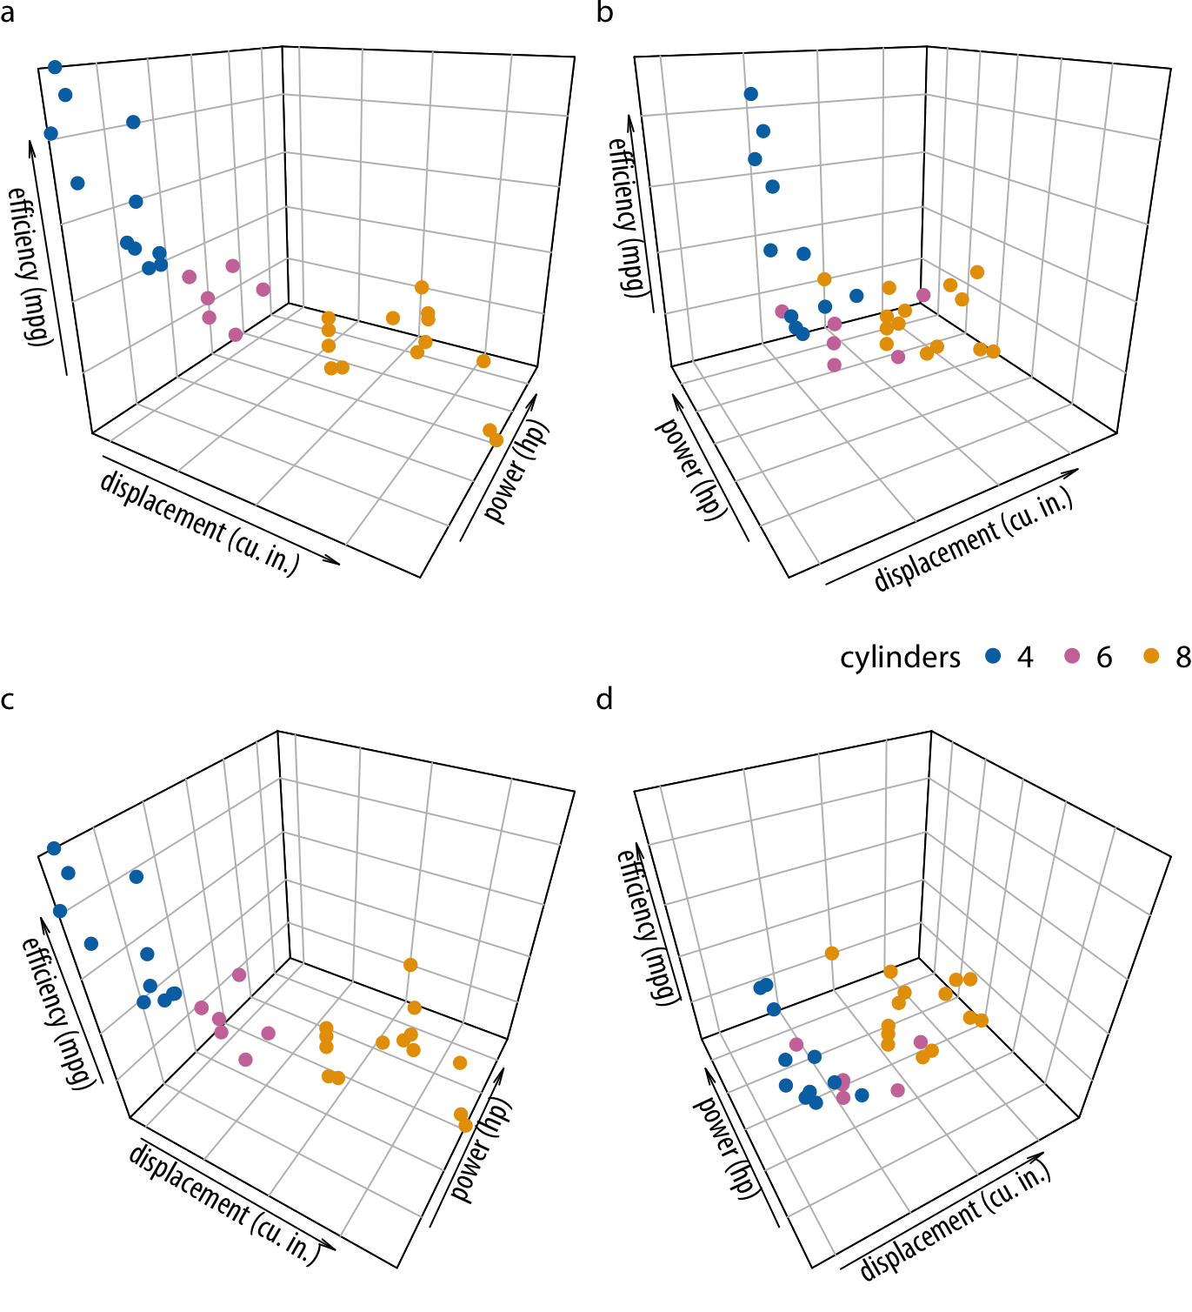
Avoid 3D position scales

Slide 49
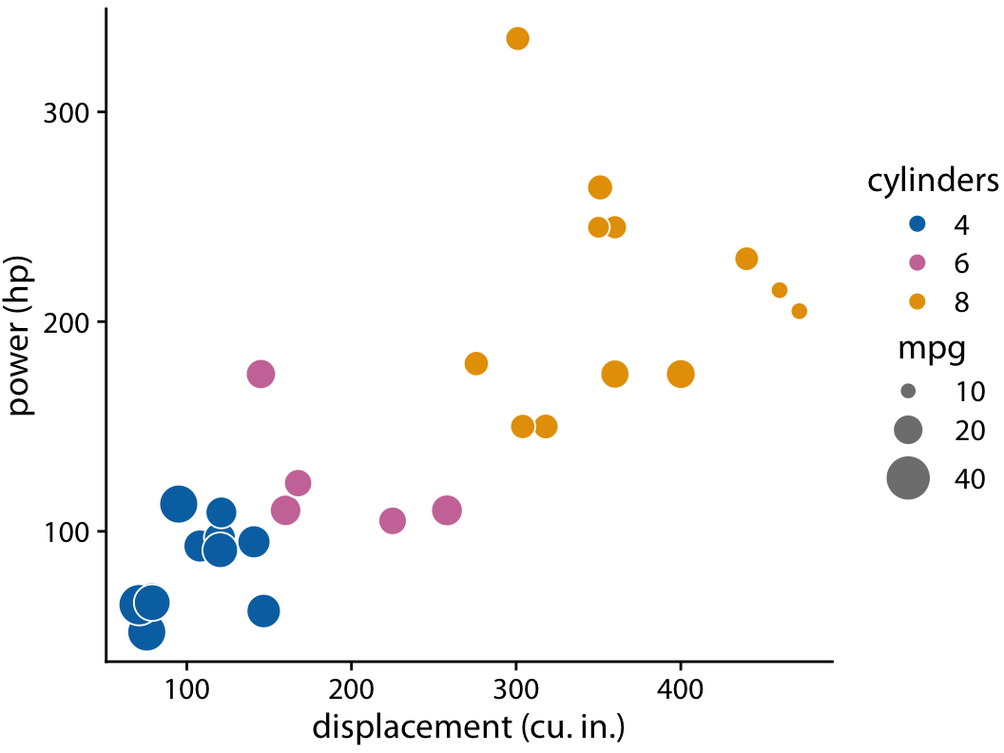
Avoid 3D position scales

Slide 50
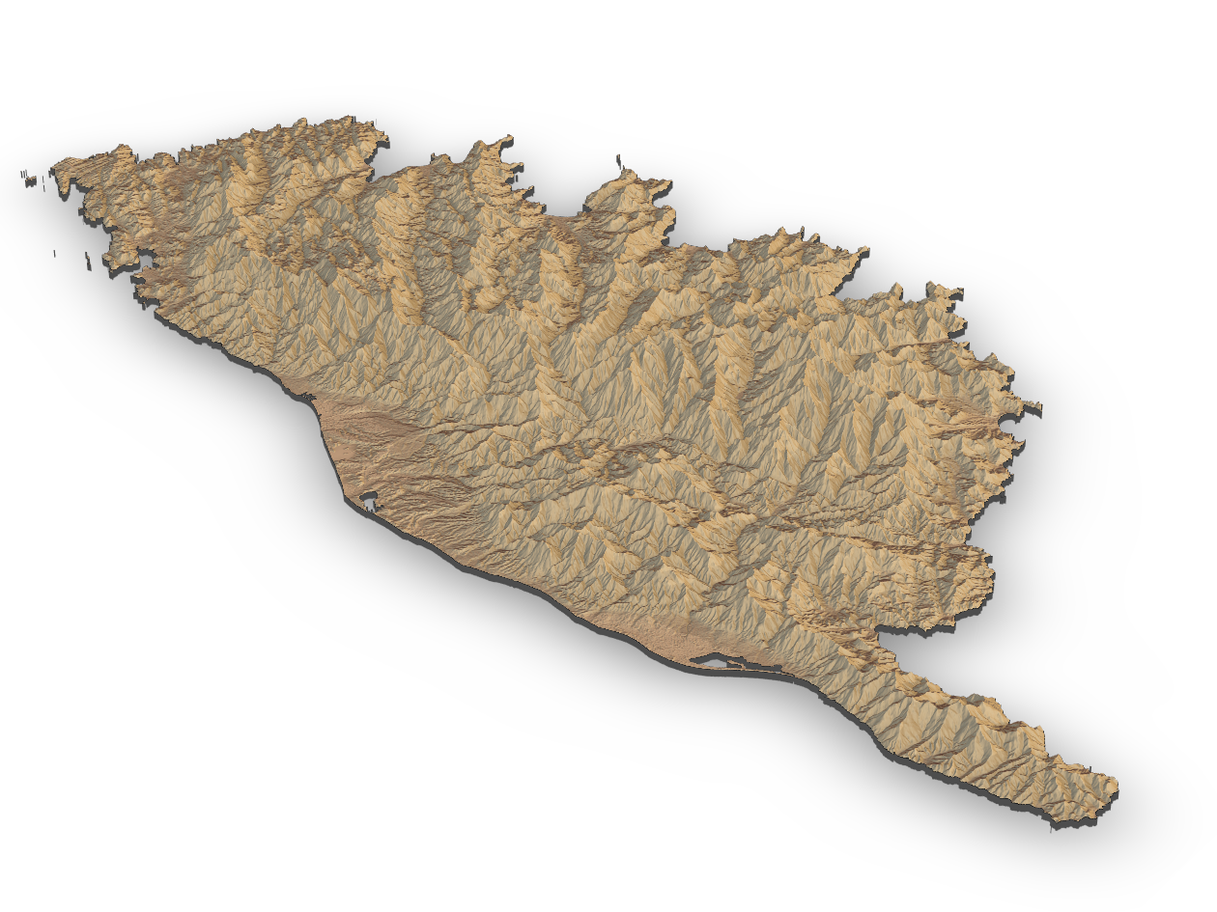
Appropriate use of 3D visualizations

Slide 51
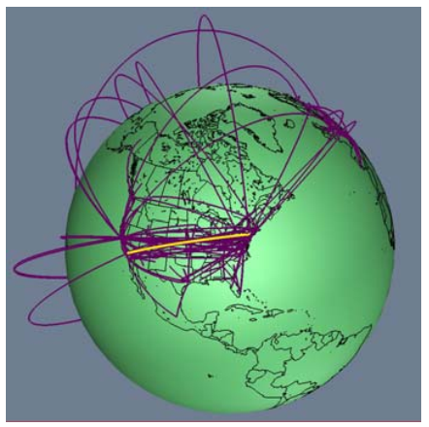
2D vs. 3D

Slide 52
Diskusi

Slide 53
Conclusion
We have presented a reference model that describes the procedure that generates interactive visual representations from data, by means of a pipeline of three stages: preprocessing and data transformations, visual mapping, and view creation.
Each of these was analyzed in detail with a practical example.

